Slide 1
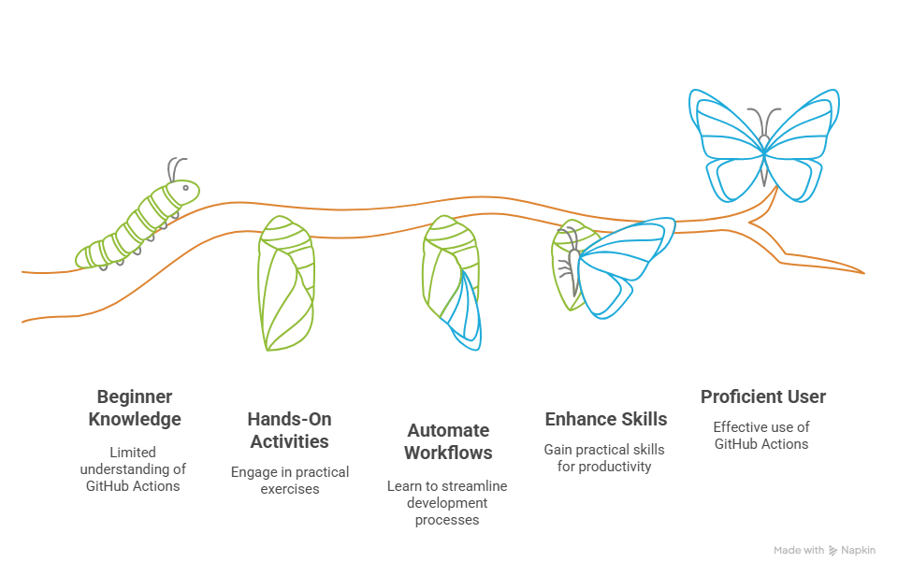

GitHub Actions Workshop

Slide 2
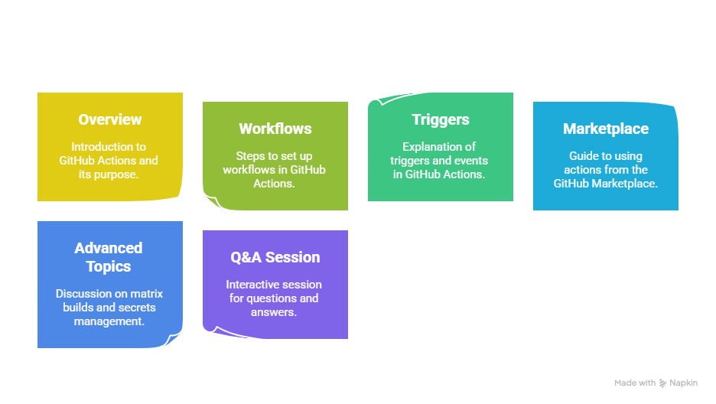
Agneda

Slide 3

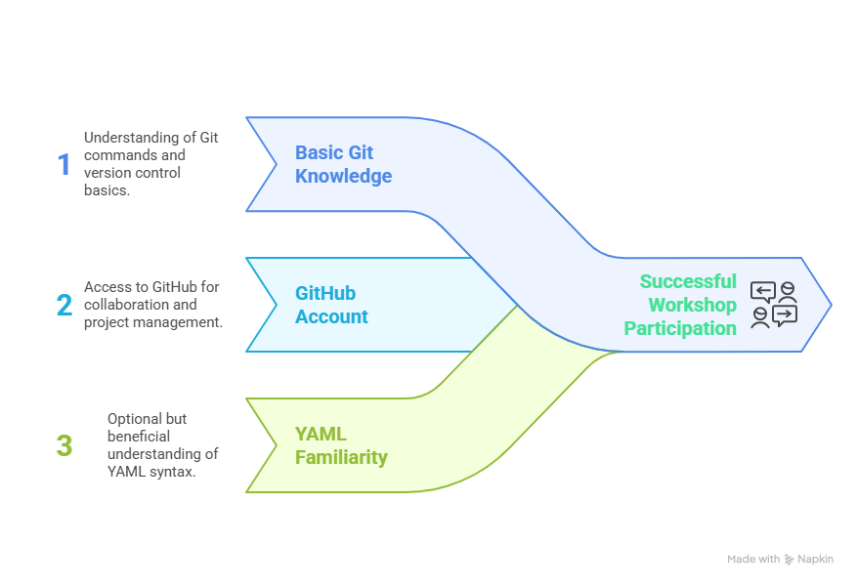



Workshop Prerequisites

Slide 4
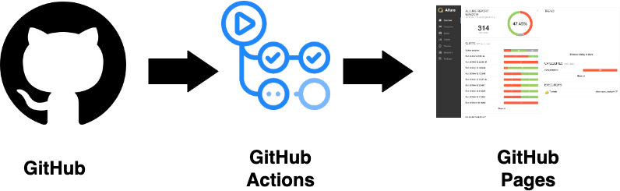
What is GitHub Actions?
GitHub Actions is a CI/CD tool integrated into GitHub.
Automates tasks like testing, building, and deploying code.
Runs workflows directly in your GitHub repository.

Slide 5
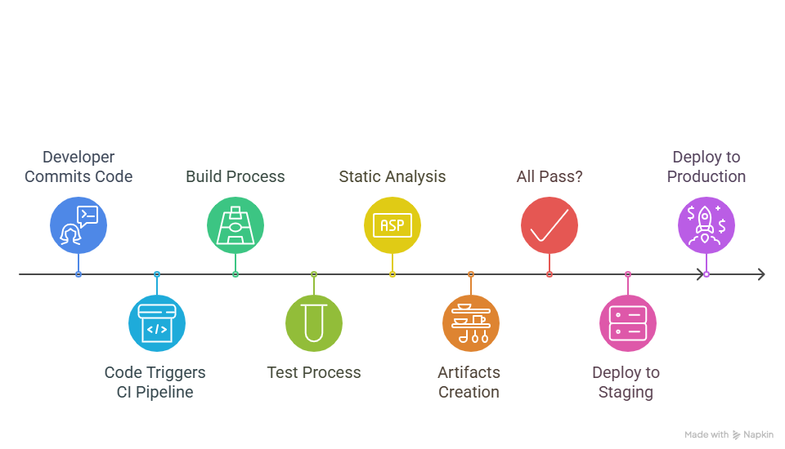
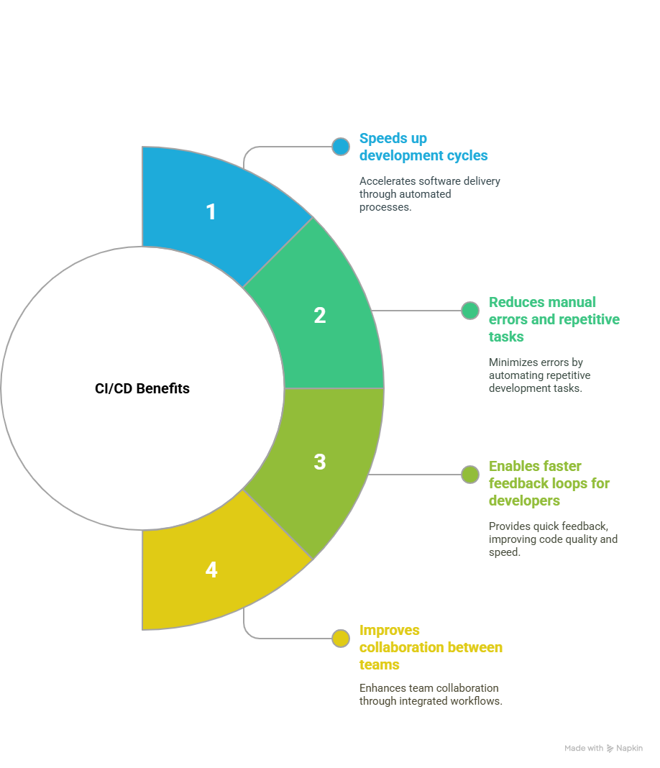
What is CI/CD?

Slide 6
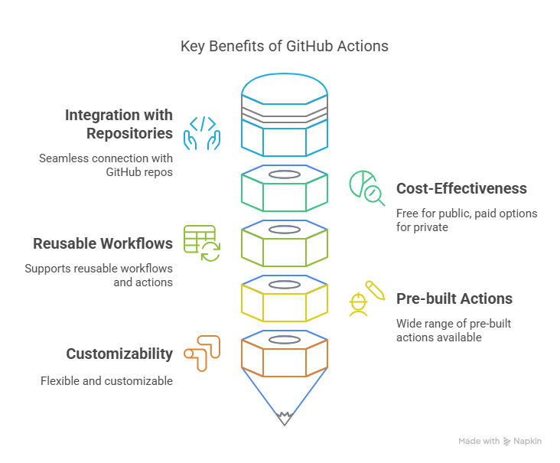
Why Use GitHub Actions?
https://github.com/marketplace

Slide 7
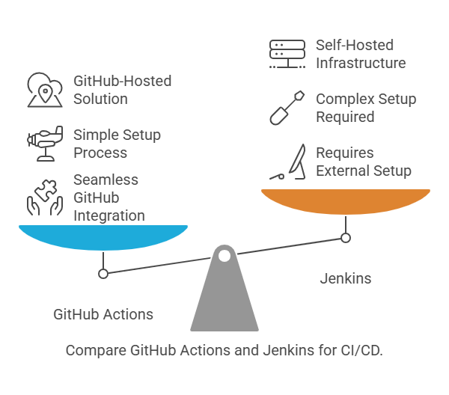
GitHub Actions vs. Jenkins

Slide 8
GitHub Actions vs. Jenkins
Feature/Criteria | GitHub Actions | Jenkins
Integration with GitHub | Fully integrated with GitHub repositories. Workflows are defined directly in the repository. | Requires plugins or external configuration to integrate with GitHub.
Ease of Setup | No installation required. Workflows are configured via YAML files in .github/workflows/. | Requires installation and configuration on a server or local machine.
Hosting | Hosted by GitHub. No need to manage infrastructure. | Self-hosted. Requires maintenance of servers and plugins.
Pre-built Actions | Extensive library of pre-built actions available in the GitHub Marketplace. | Requires plugins for most tasks
YAML Configuration | Uses simple YAML files for defining workflows. | Uses Groovy scripts or Jenkinsfile for pipeline configuration
Community Support | Backed by GitHub’s ecosystem and community. | Large community with extensive plugin library
Custom Runners | Supports self-hosted runners for private environments. | Supports custom agents
Reusability | Workflows and actions can be reused across repositories. | Pipelines can be reused
Learning Curve | Beginner-friendly with intuitive YAML syntax and documentation. | Steeper learning curve due to complex configurations and plugin dependencies.

Slide 9
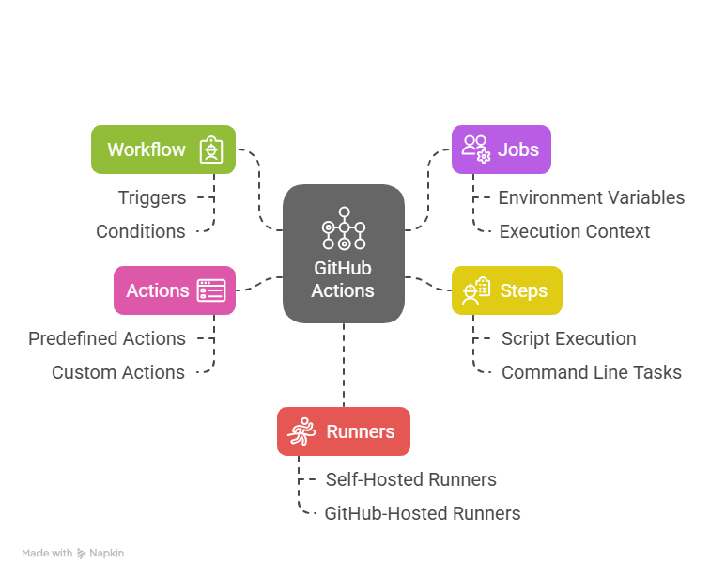
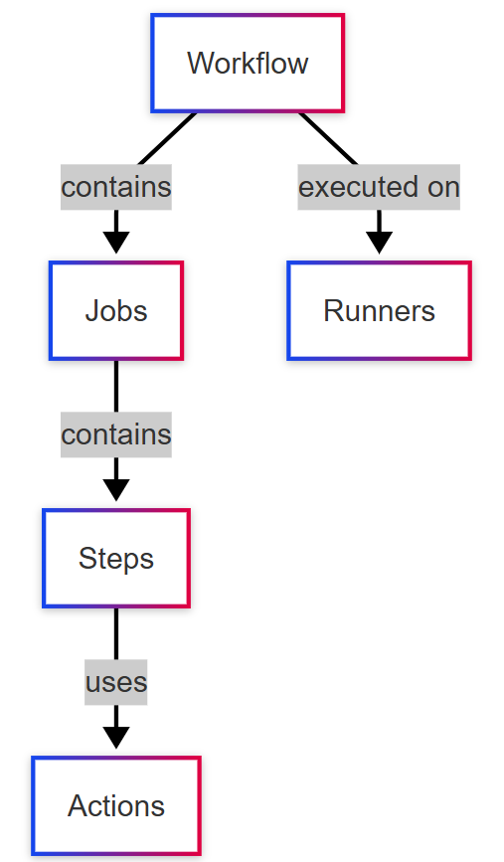
GitHub Actions Key Concepts

Slide 10
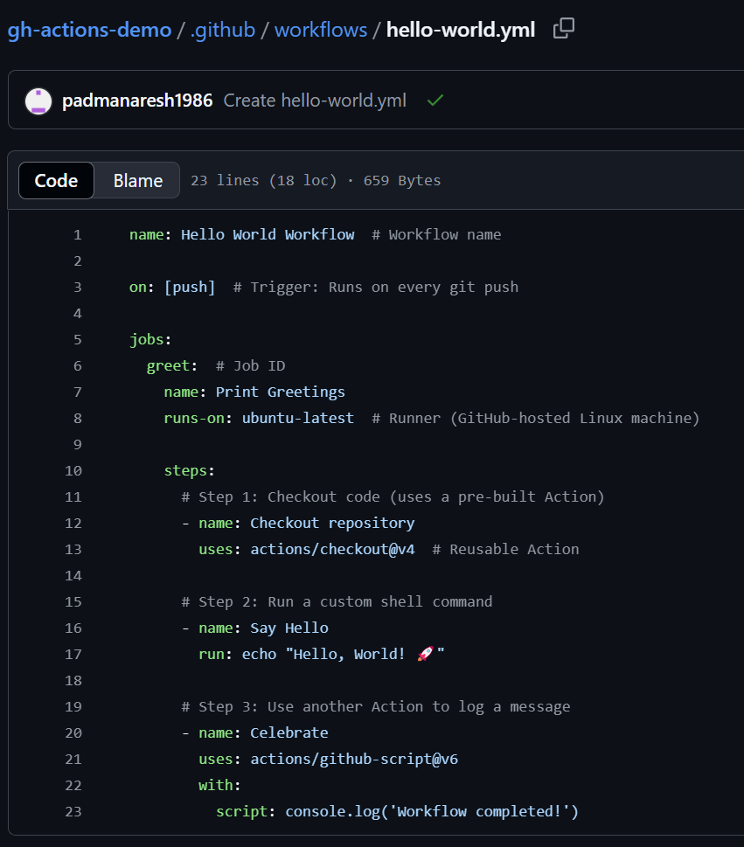
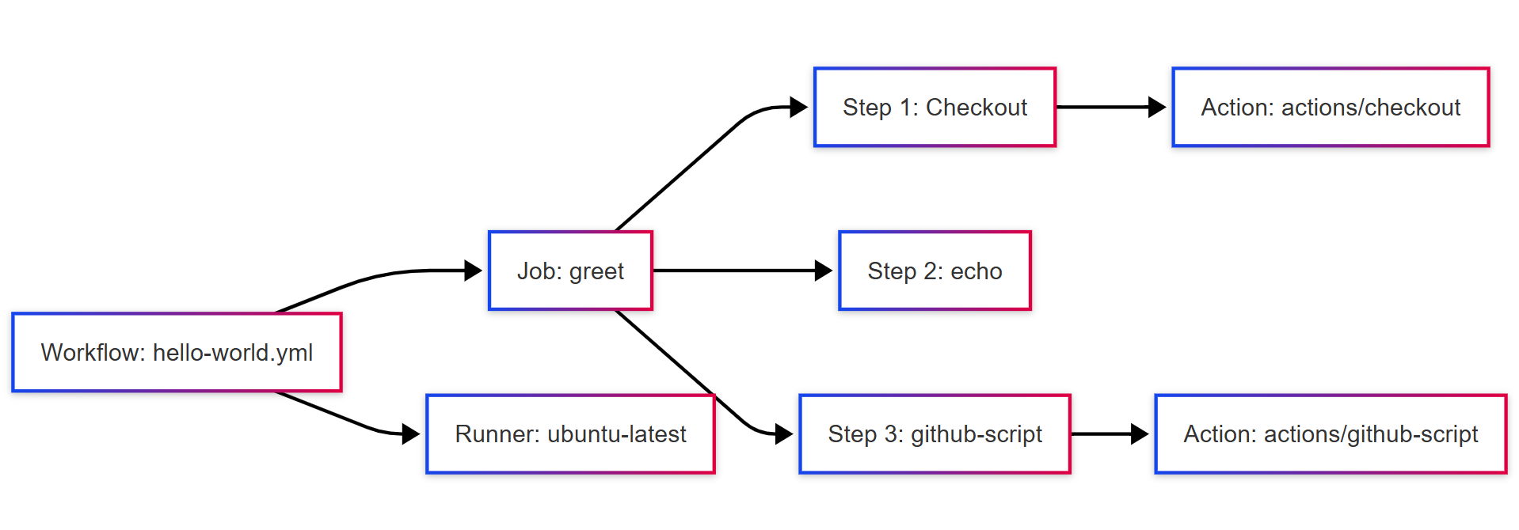
Creating a Workflow File (Demo)
Workflow files are stored in .github/workflows/
Written in YAML format
Define triggers, jobs, and steps.

Slide 11
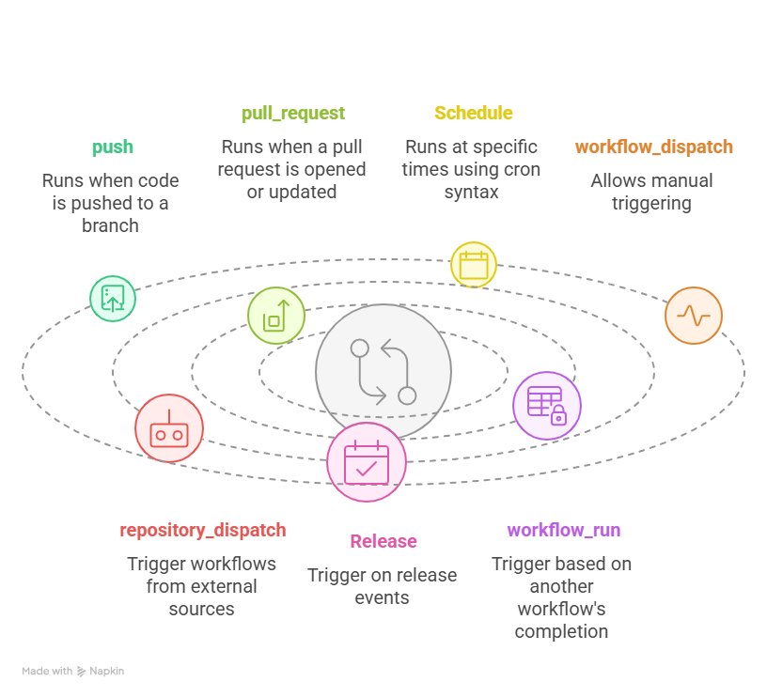
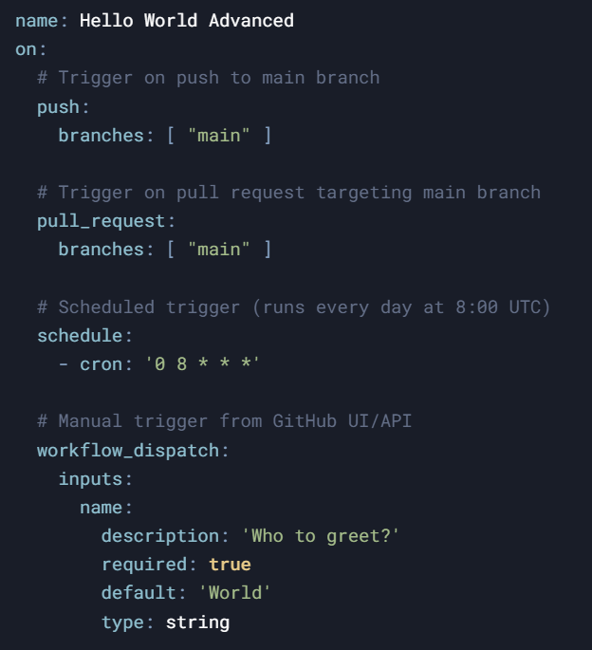
Workflow Triggers

Slide 12
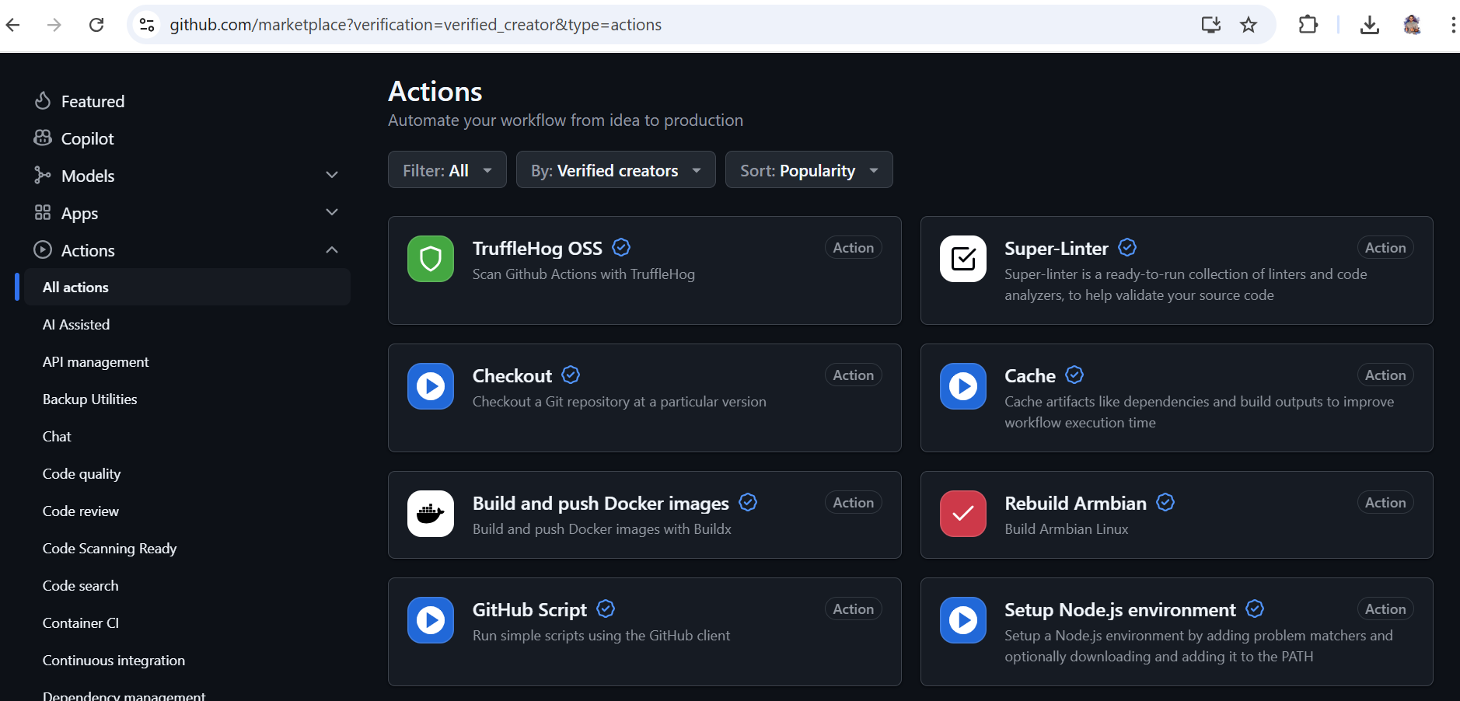
What are Actions?
Pre-built reusable components for workflows.
Available in the GitHub Actions Marketplace.
Simplify complex tasks like setting up environments or deploying code.

Slide 13
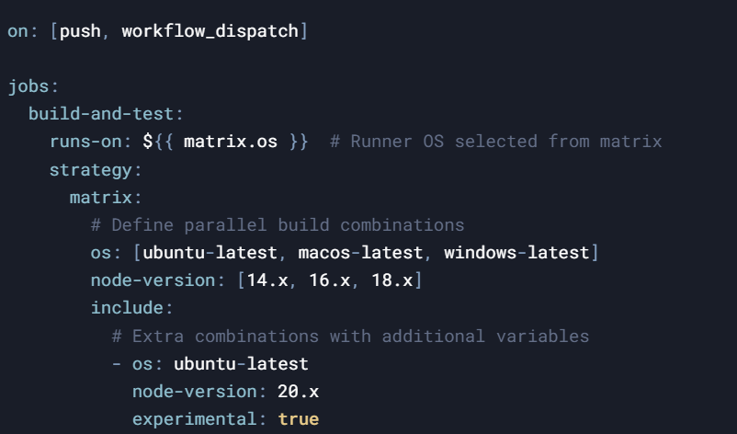
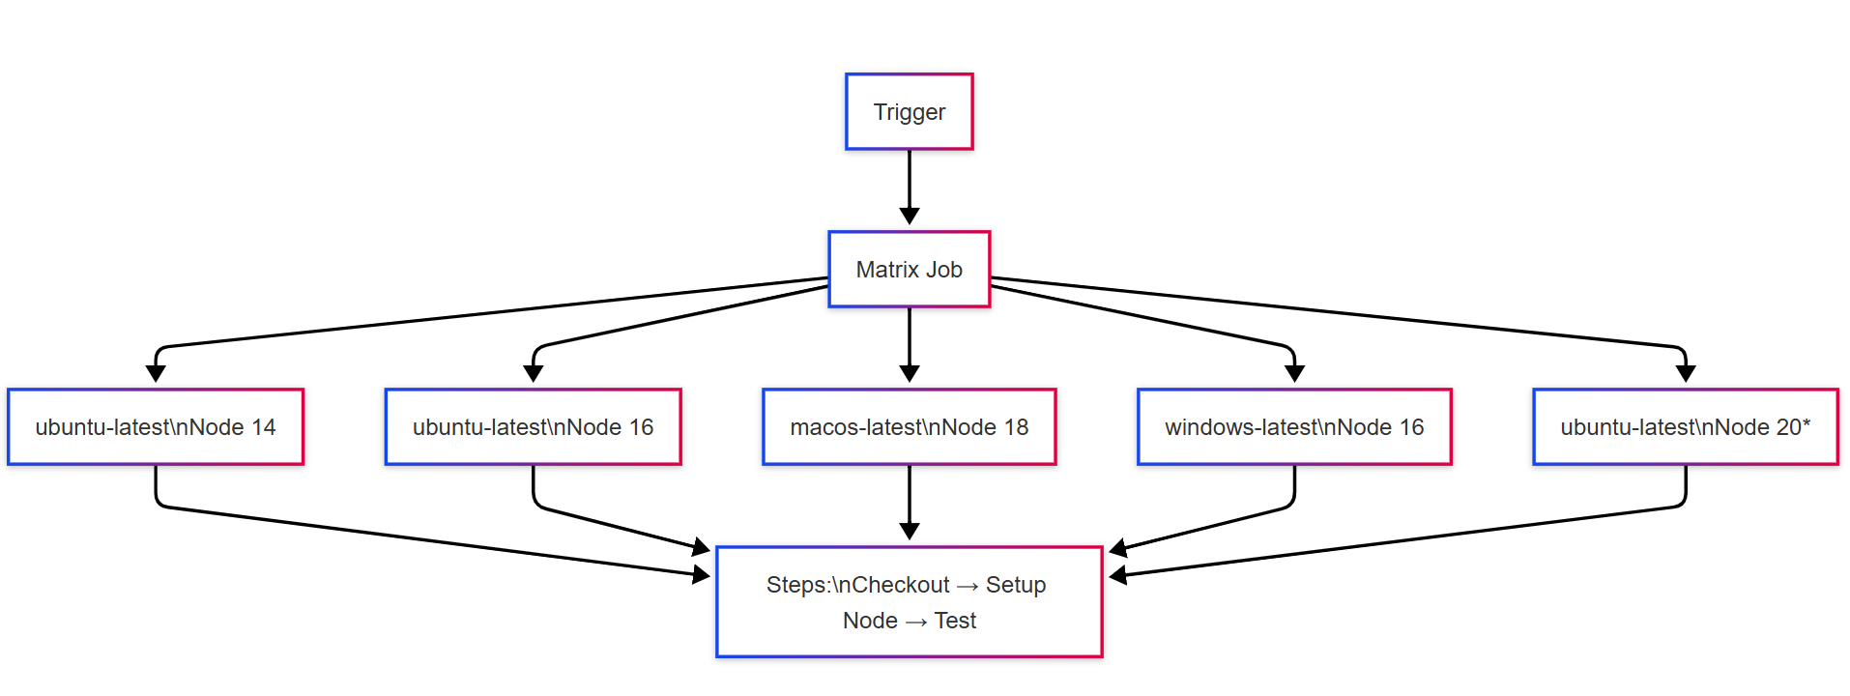
Matrix Builds
Run jobs across multiple configurations (e.g., OS, Node.js versions).
Saves time by parallelizing tasks.
Cross-platform testing (Linux/macOS/Windows).

Slide 14
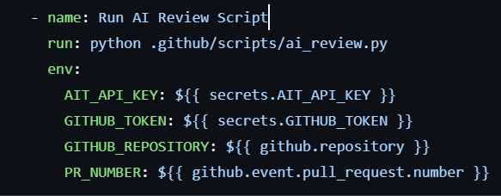
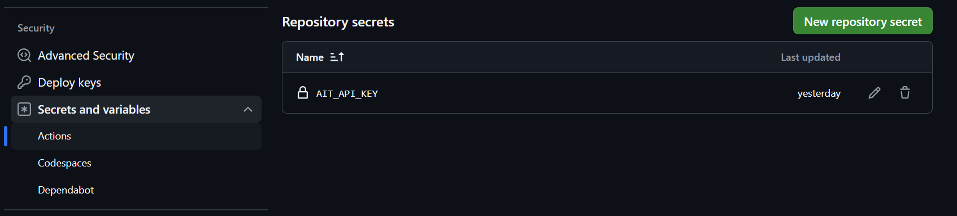
Secrets Management
Store sensitive data like API keys in GitHub Secrets.
Access secrets securely in workflows using ${{ secrets.SECRET_NAME }}.

Slide 15
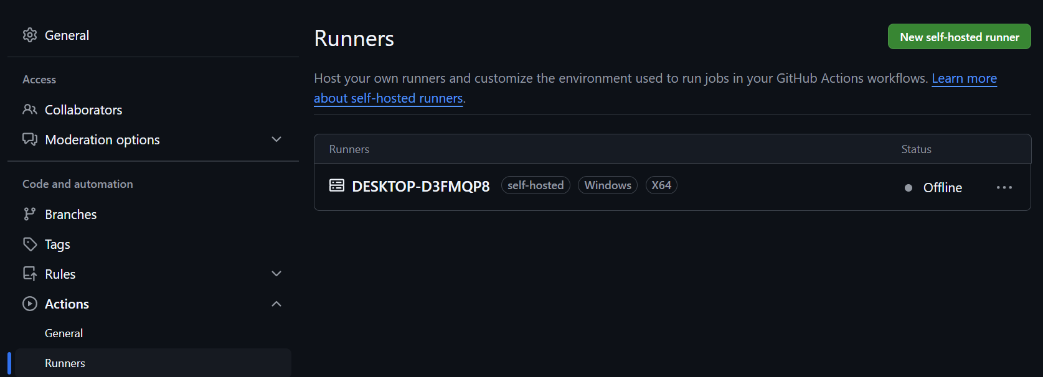
Self-Hosted Runners
Use custom runners for private environments.
Ideal for organizations with specific hardware or software requirements.

Slide 16
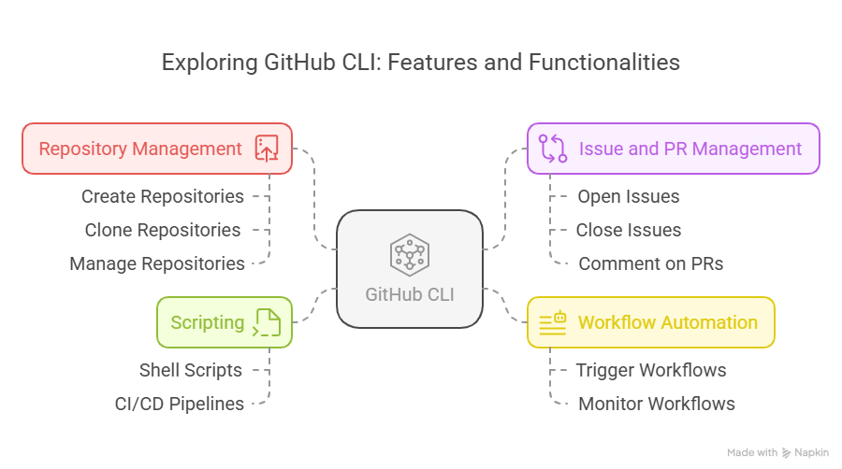
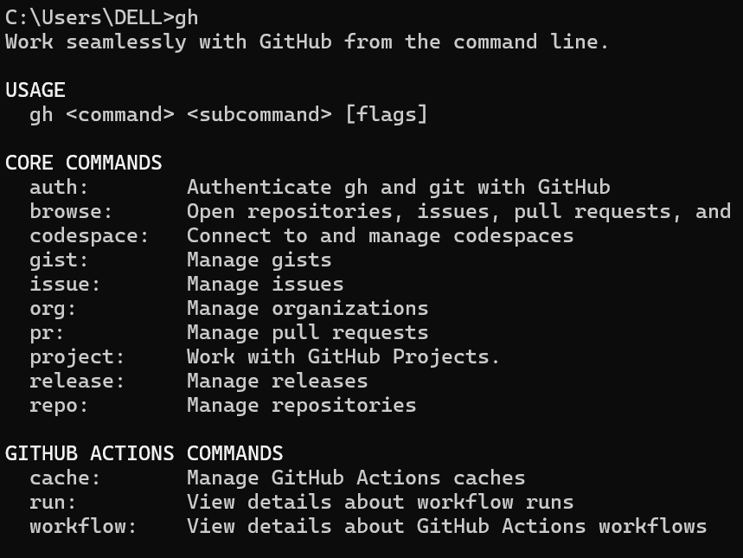
Introducing GitHub CLI

Slide 17
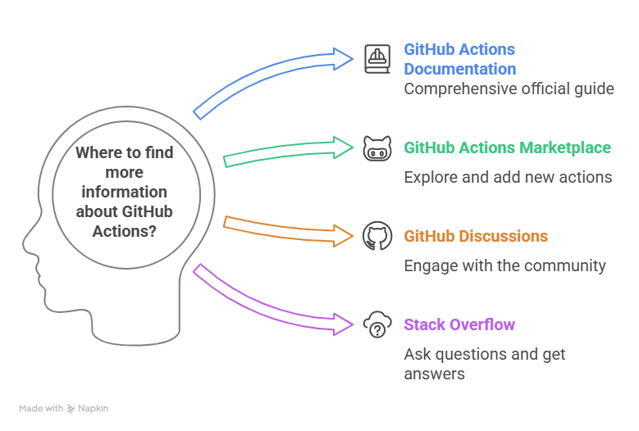
https://docs.github.com/actions
https://github.com/marketplace
https://github.com/orgs/community/discussions
https://stackoverflow.com/questions/tagged/github-actions

Slide 18
Thank You

